Slide 1
Building iOS Swift apps
5030-201720_MCS5993_M: 5030-Topics in Computer Science
5031-201720_MCS4993_M: 5031-Topics in MA/CS

Slide 2
Agenda
Chapter 3 and 4 from Nobledesktop book
Assignments – Word Count, Features list

Slide 3
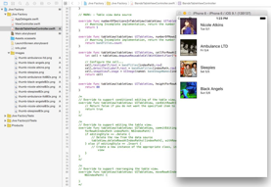
Chapter 3
Notes:
The list of upcoming shows we built in the previous exercise is looking good, but we really need these cells to be created dynamically so they are easier to update when we need to add more shows. In this exercise, we will write code to populate the table instead of manually setting each cell in the Editor.

Slide 4
Save your work
git add .
git commit –m “Chapter 2”
Notes:
Will probably just add the new images

Slide 5
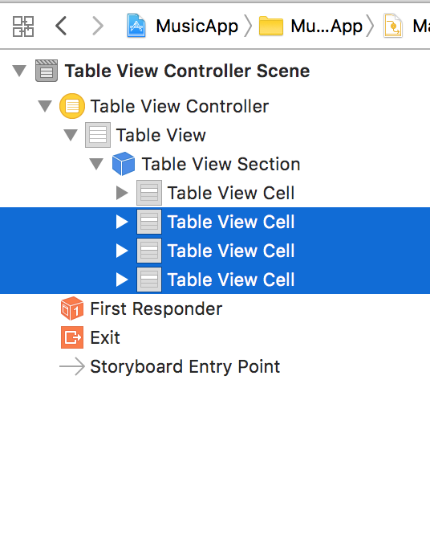
Notes:
We want to keep the look and feel of the cells we built in the previous exercise. We’ll use the first cell as a template, but we don’t need the rest of them.
In the Editor, click the Ambulance LTD cell to select it.
Shift–click on the Black Angels cell to select the three others.
Hit Delete.
In the Document Outline, click Table View to select it.
In the Attributes inspector , from the Content menu, choose Dynamic Prototypes.
In the Document Outline, select Table View Cell.
In the Attributes inspector , next to Identifier, type bandCell and hit Return.
This defines a name we can use to programmatically refer to this later.

Slide 6
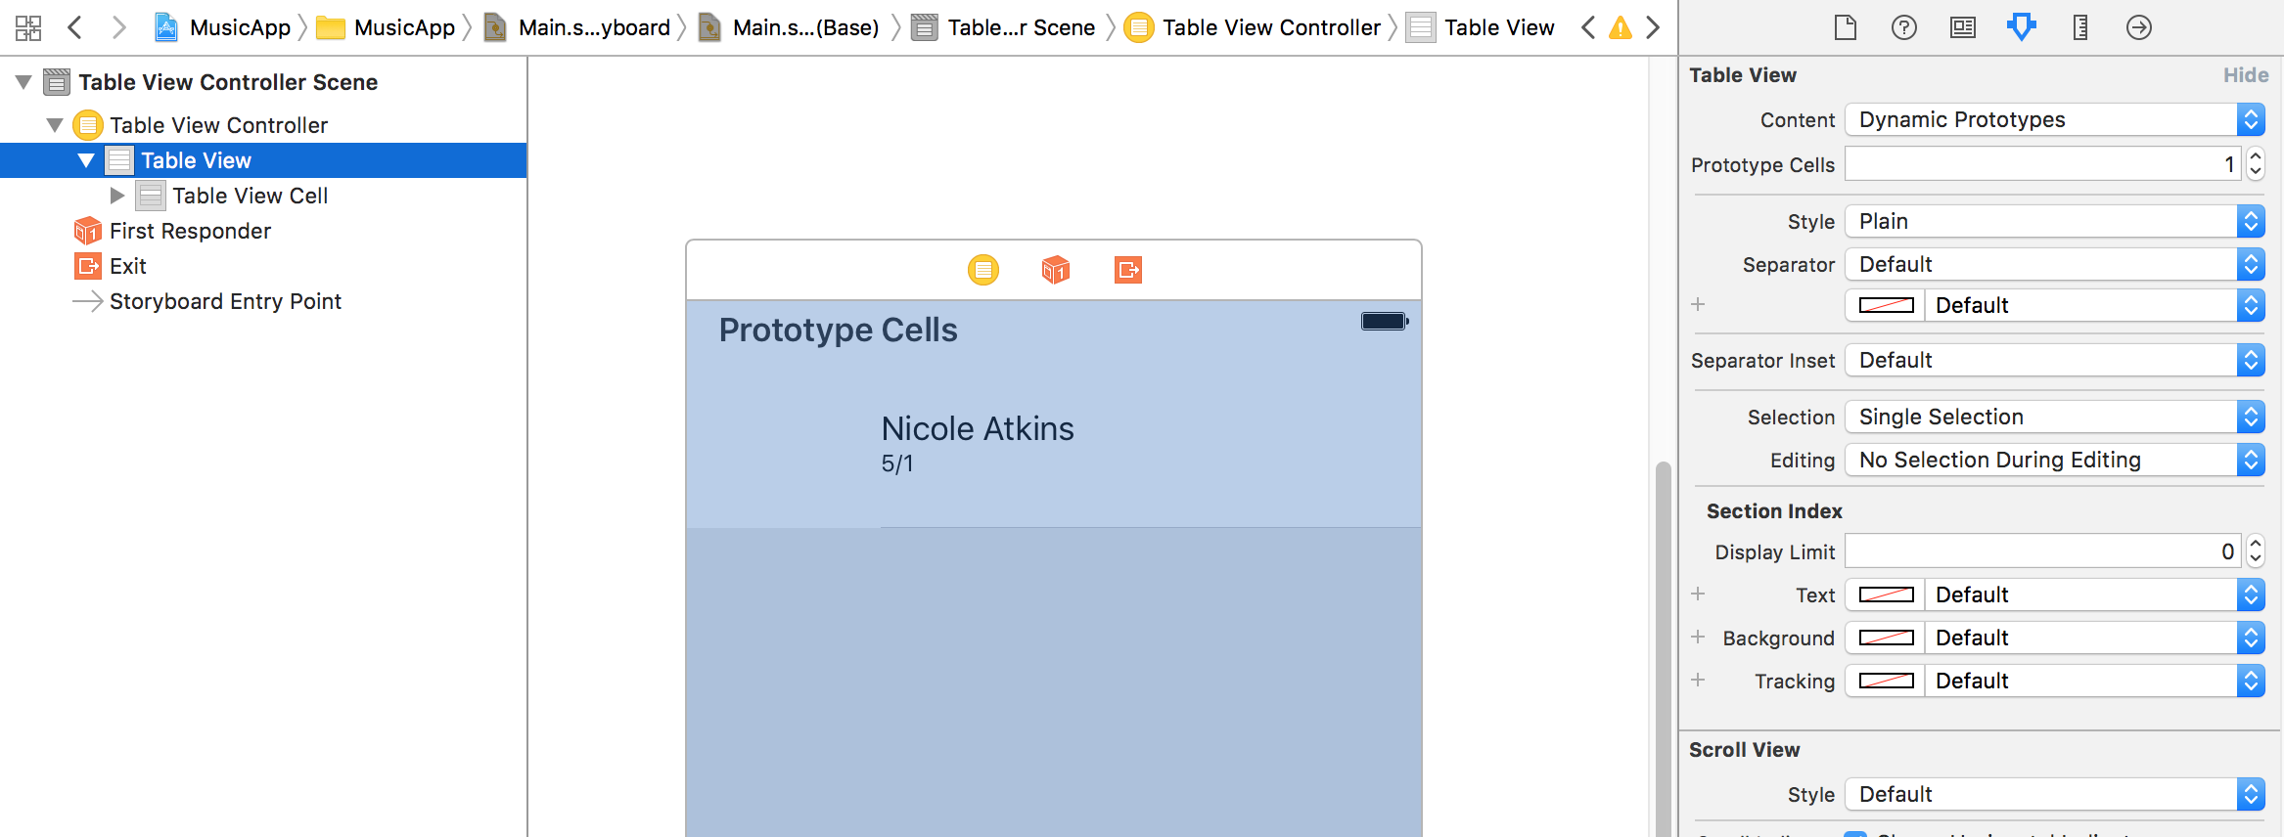
Notes:
In the Attributes inspector , from the Content menu, choose Dynamic Prototypes.

Slide 7
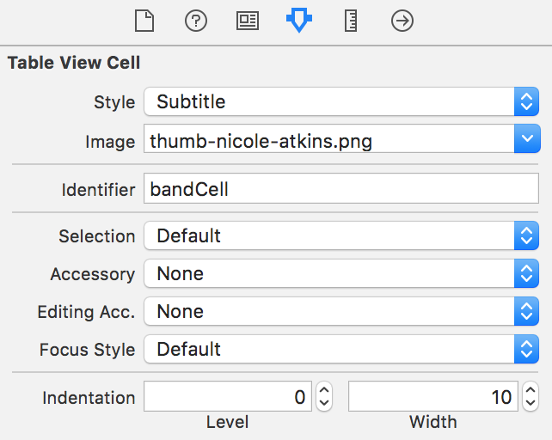
Notes:
In the Document Outline, select Table View Cell.
In the Attributes inspector , next to Identifier, type bandCell and hit Return.
This defines a name we can use to programmatically refer to this later.

Slide 8
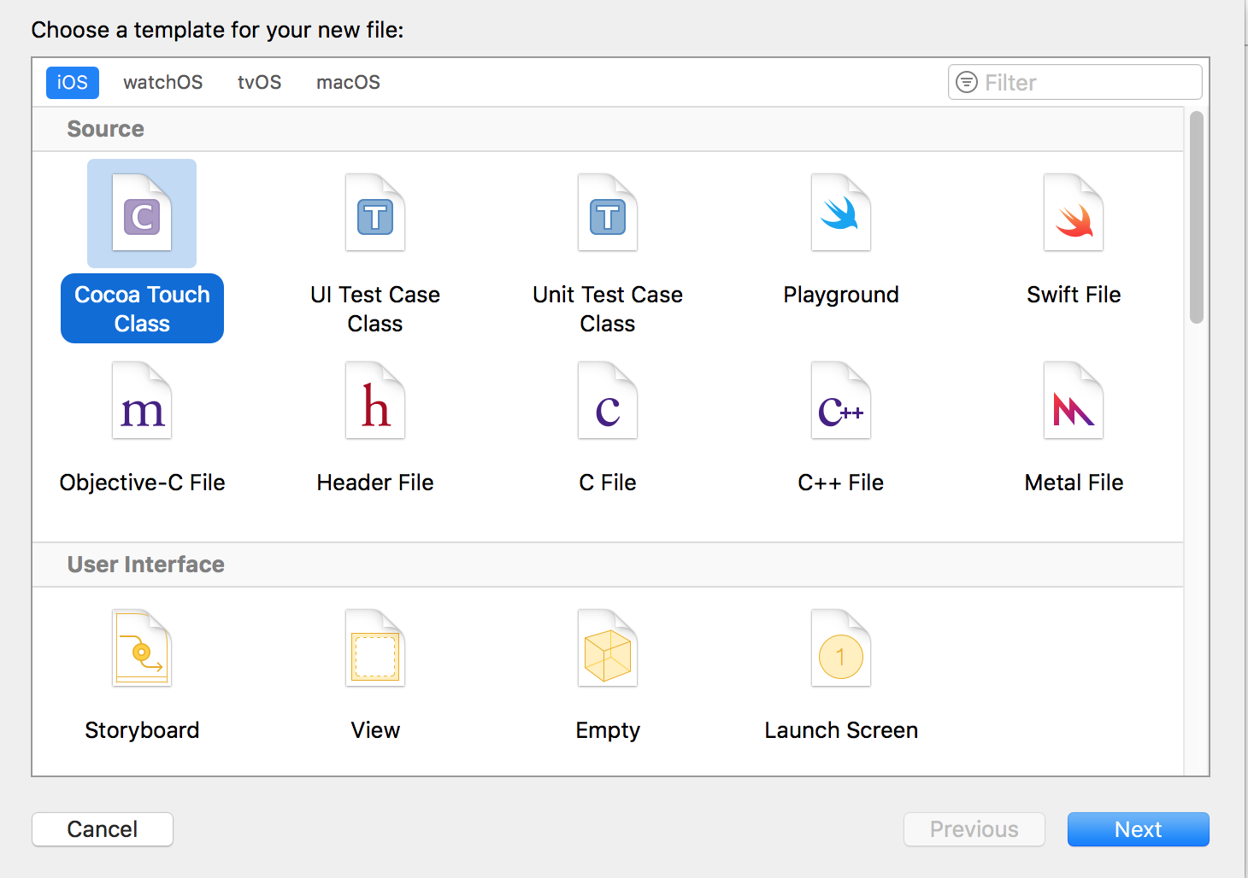
Notes:
Creating a Class
We need to create a new class that we can customize to populate the cells dynamically.
In the Project Navigator, select ViewController.swift. (We want the file to be added after this file, that’s why we had you select it.)
Go to File > New > File.
On the left, under iOS, make sure Source is selected.
Double–click Cocoa Touch Class to choose it.

Slide 9
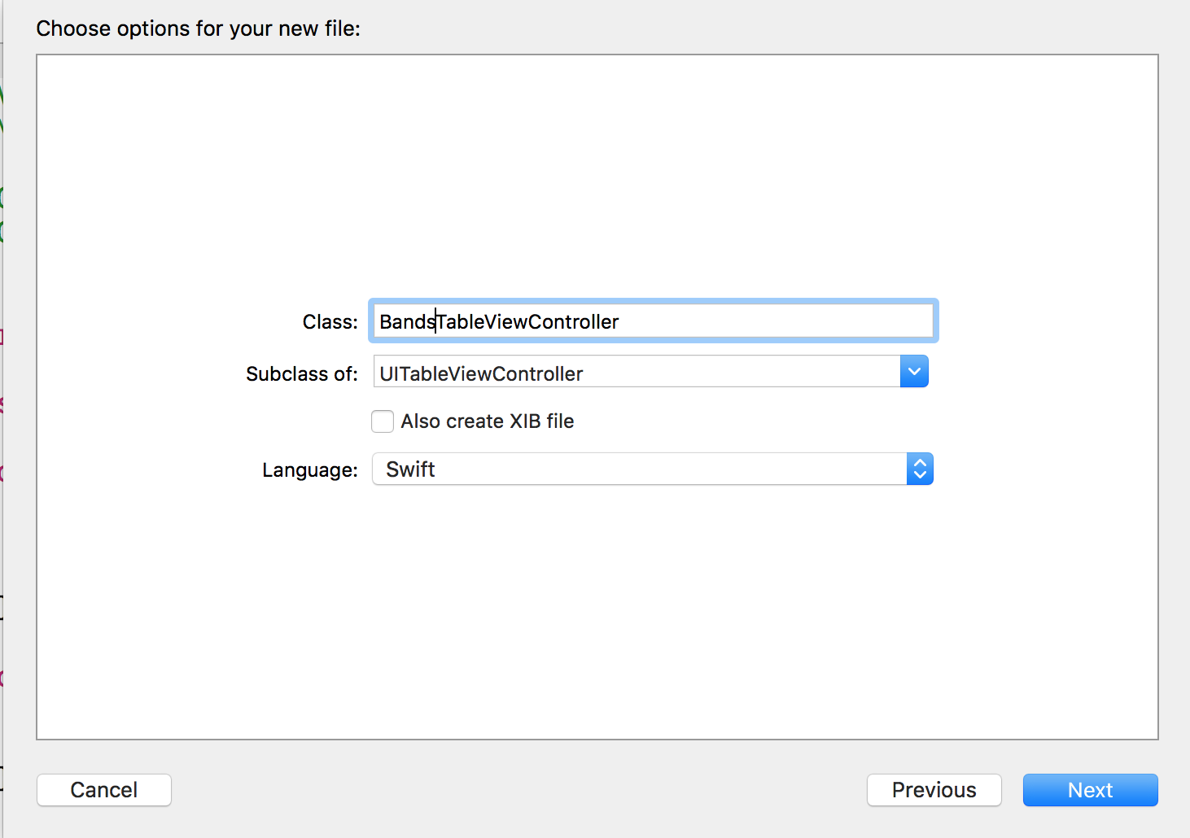
Notes:
From the Subclass of menu, choose UITableViewController. (Be careful to choose the UITableViewController, not the UIViewController!)
Edit the name of the Class to be: BandsTableViewController
NOTE: UITableViewController is the object we are currently using on the storyboard.
By making our class a subclass of the UITableViewController, it will have all the functionality it currently has, plus any additional functionality we add in the code to this new BandsTableViewController class.

Slide 10
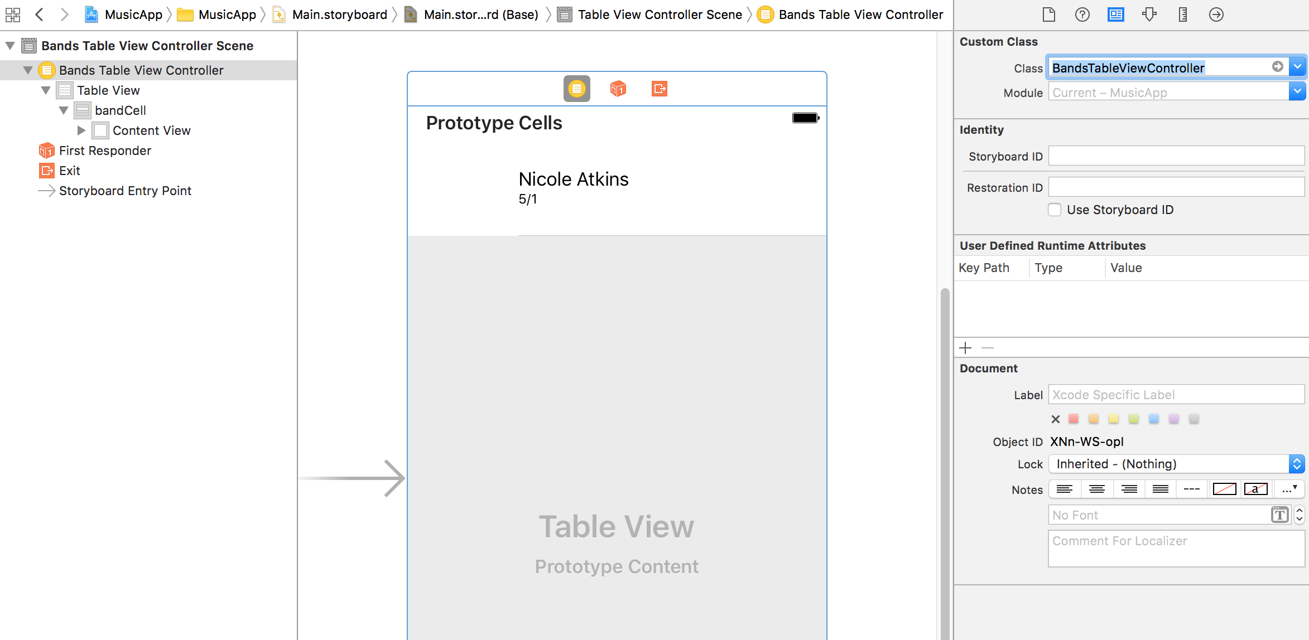
Notes:
Let’s connect the view we have in the storyboard to our new class. In the
Document Outline, click Table View Controller.
In the Utilities area on the right, click the Identity inspector tab .
Next to Class, type B and Xcode should autocomplete to:
BandsTableViewController
NOTE: Sometimes Xcode takes a while to recognize a new class, so if you do not see any autocomplete suggestions, you will just have to type it in manually.
Hit Return to apply the change.
In the Document Outline, click Table View.
In the Utilities area on the right, click the Connections inspector tab .
Notice that dataSource and delegate are now connected to the Bands Table View Controller. Awesome! Now we can start adding the code we need to populate the cells.
Go to File > Save or hit Cmd–S.

Slide 11
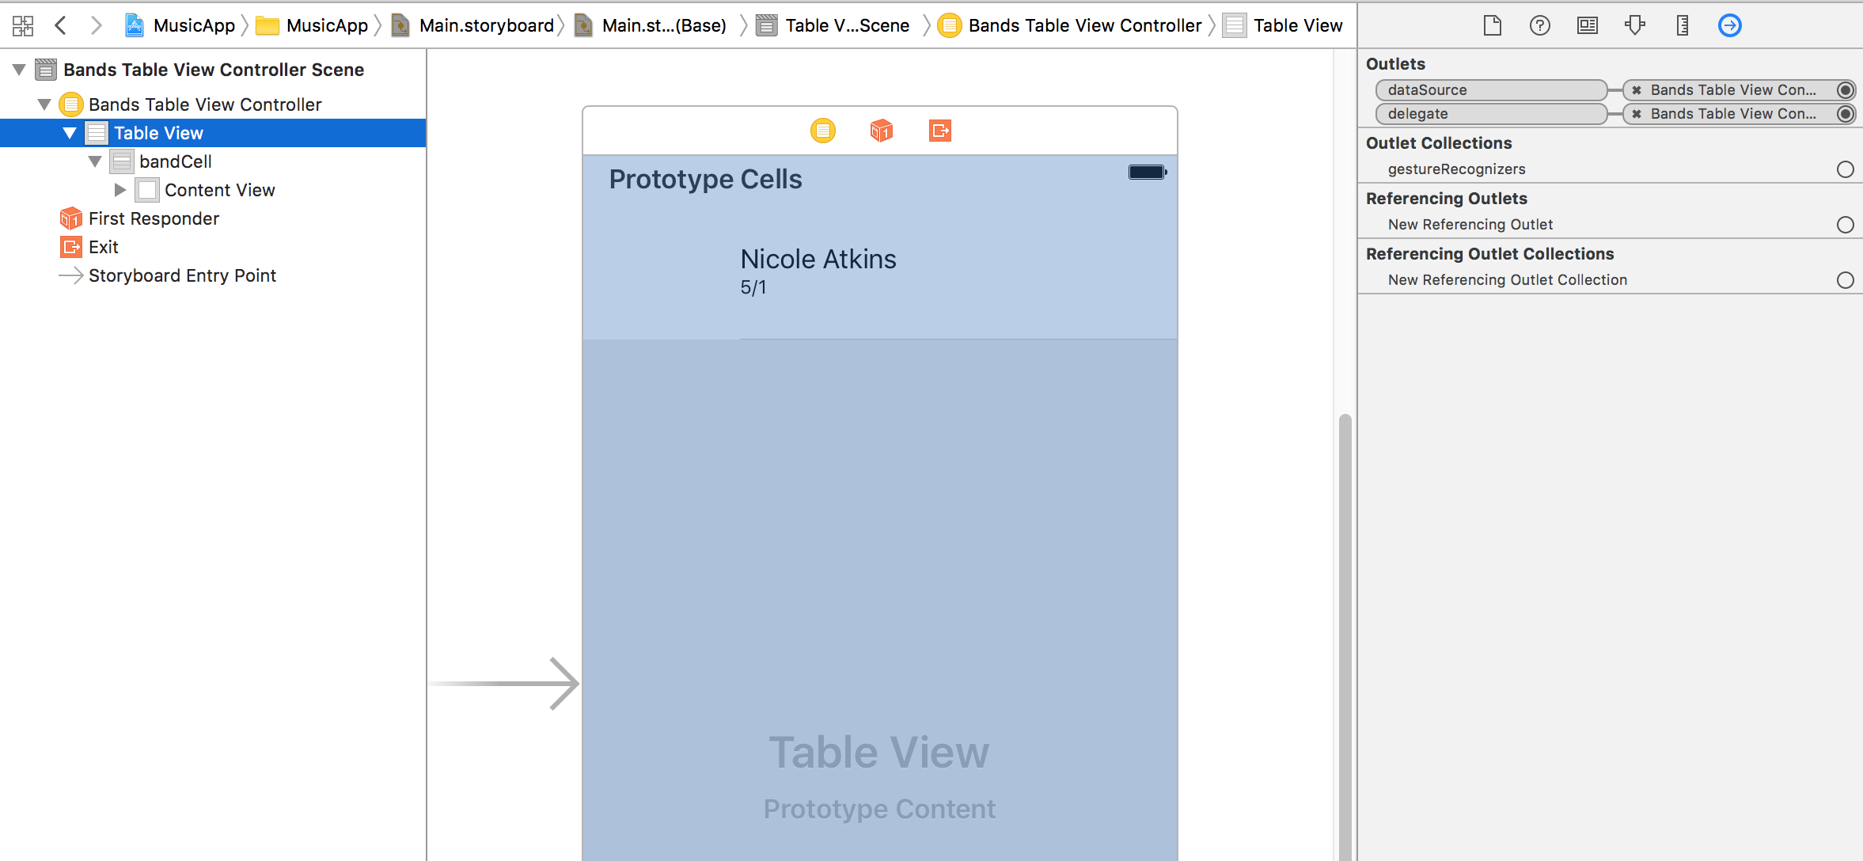
Notes:
In the Document Outline, click Table View.
In the Utilities area on the right, click the Connections inspector tab .
Notice that dataSource and delegate are now connected to the Bands Table View Controller.
Now we can start adding the code we need to populate the cells.

Slide 12
class BandsTableViewController: UITableViewController {
let bandTitles = ["Nicole Atkins", "Ambulance LTD", "Sleepies", "Black Angels"]
override func viewDidLoad() {
Notes:
Adding Properties for the Band Data
Before we can draw the table and all the cells, we need to represent the data (title, subtitle, image) for all the bands in the code. Let’s start by creating properties for the Title, Subtitle, and Image.
In the Project Navigator, click on BandsTableViewController.swift to open it.
Add the following array for the band titles around line 13:
class BandsTableViewController: UITableViewController {
let bandTitles = ["Nicole Atkins", "Ambulance LTD", "Sleepies", "Black Angels"]
override func viewDidLoad() {
Recall that an array is a type of data collection used to hold a list of items. You will notice that this array is a constant, which means once you have set the values for this array, the data cannot be changed. It’s also worth noting that arrays must contain all one type of data. In this case, the data that this array contains is of the type String.

Slide 13
let bandTitles = ["Nicole Atkins", "Ambulance LTD", "Sleepies", "Black Angels"]
let bandSubTitles = ["Tue 5/1", "Fri 5/4", "Sat 5/5", "Sun 5/6",]
let bandImageNames = ["thumb-nicole-atkins.png", "thumb-ambulance-ltd.png", "thumb-sleepies.png", "thumb-black-angels.png"]
override func viewDidLoad() {
Notes:
After the bandTitles property, add the following code:
let bandTitles = ["Nicole Atkins", "Ambulance LTD", "Sleepies", "Black Angels"]
let bandSubTitles = ["Tue 5/1", "Fri 5/4", "Sat 5/5", "Sun 5/6",]
let bandImageNames = ["thumb-nicole-atkins.png", "thumb-ambulance-ltd.png", "thumb-sleepies.png", "thumb-black-angels.png"]
override func viewDidLoad() {
Go to File > Save.

Slide 14
numberOfSectionsInTableView: (around line 34)
numberOfRowsInSection: (around line 39)
cellForRowAtIndexPath: (around line 45)
Notes:
In the Project Navigator, select BandsTableViewController.swift.
When we created the BandsTableViewController class, Xcode automatically provided us with methods to use. Some of the methods are optional and have been commented out. Others have commented code before them, which are hints that Xcode gives us for methods that we might want to implement to customize the look, feel and data that we want in our app.
Around line 32, find the // MARK: - Table view data source comment code.
Below that, there are three methods we’ll need to modify to get the band information displaying in our app:

Slide 15
override func numberOfSectionsInTableView(tableView: UITableView) -> Int {
#warning Incomplete implementation, return the number of sections
return 1
}
Notes:
These methods are part of the dataSource protocol. The first method is numberOfSectionsInTableView:.
This method returns the number of sections so that the BandsTableViewController knows how many to draw and how many to loop through. We’ll just have one section, so change 0 to 1 as shown below:
override func numberOfSectionsInTableView(tableView: UITableView) -> Int {
#warning Incomplete implementation, return the number of sections
return 1
}

Slide 16
override func tableView(tableView: UITableView, numberOfRowsInSection section: Int) -> Int {
// #warning Incomplete implementation, return the number of rows
return bandTitles.count
}
Notes:
The next method is numberOfRowsInSection. This method will be called for each section in the table. Since we only have one section, it will only be called once. We need to return the total number of bands that will be drawn. This number will depend on the number of bands we have, which varies, but we can get the number of bands by accessing the size of our array with some simple code. Add the following bold code to the numberOfRowsInSection method, replacing the 0:
override func tableView(tableView: UITableView, numberOfRowsInSection section: Int) -> Int {
// #warning Incomplete implementation, return the number of rows
return bandTitles.count
}
This code takes the array bandTitles and accesses a method called count. The count method gives us the size of the array. After this method has the size of the array, it will tell the View Controller how many times to call the next method, cellForRowAtIndexPath:.

Slide 17
override func tableView(_ tableView: UITableView, cellForRowAt indexPath: IndexPath) -> UITableViewCell {
let cell = tableView.dequeueReusableCell(withIdentifier: "bandCell", for: indexPath)
// Configure the cell...
return cell
}
Notes:
cellForRowAtIndexPath: returns the cell object with all the data it needs to draw the title, subtitle, and image. It is called for each row and it passes in a parameter called indexPath, which will tell us which row is currently being called for. What we need to do next is build a cell object with the data we want the table to draw.
If you remember, earlier in the exercise we set the Cell Identifier of the Nicole Atkins cell in the storyboard to bandCell. To target the cell on our storyboard we need to edit this code.
Now that we have the correct cell being targeted, let’s look at the rest of the code. The code in cellForRowAtIndexPath: grabs the cell from the storyboard by using a method dequeueReusableCellWithIdentifier: to pass in the Identifier cell. The method is called and passes in an indexPath variable to the tableView object. indexPath specifies the section and row that it will be working with. That instantiates a cell object, which we want to further customize by adding our band data into it.

Slide 18
override func tableView(_ tableView: UITableView, cellForRowAt indexPath: IndexPath) -> UITableViewCell {
let cell = tableView.dequeueReusableCell(withIdentifier: "bandCell", for: indexPath)
// Configure the cell...
cell.textLabel?.text =
return cell
}
Notes:
Customizing the Cells
Find the // Configure the cell comment code around line 47.
This is where we will be adding the code that will customize the cells with our band info. To start with, we need to access the label for the Title in our cell. The Title label is represented by the attribute textLabel. We need to redefine the text in the textLabel in the cell. Add the following bold code:
// Configure the cell...
cell.textLabel?.text =
return cell

Slide 19
override func tableView(_ tableView: UITableView, cellForRowAt indexPath: IndexPath) -> UITableViewCell {
let cell = tableView.dequeueReusableCell(withIdentifier: "bandCell", for: indexPath)
// Configure the cell...
cell.textLabel?.text = bandTitles[indexPath.row]
return cell
}
Notes:
bandTitles is the name of the array with the Title info. [indexPath.row] gets the info from the array at a specific value. That value is the row that is currently being populated. Each time code passes through a cell configuration it passes the value indexPath to the method. The indexPath is what lets us know what section and what row we are currently dealing with. We access the row number by using indexPath.row. This will, in turn, fetch the corresponding value from the array. You should get used to this process of associating row numbers with array
RUN THE CODE

Slide 20
override func tableView(_ tableView: UITableView, cellForRowAt indexPath: IndexPath) -> UITableViewCell {
let cell = tableView.dequeueReusableCell(withIdentifier: "bandCell", for: indexPath)
// Configure the cell...
cell.textLabel?.text = bandTitles[indexPath.row]
cell.detailTextLabel?.text = bandSubTitles[indexPath.row]
return cell
}
Notes:
We still need to set the show date and band image.
To set the value for our detailTextLabel we will follow the same process as we did for our textLabel.
Add the following bold code below the textLabel:
RUN THE CODE

Slide 21
override func tableView(_ tableView: UITableView, cellForRowAt indexPath: IndexPath) -> UITableViewCell {
let cell = tableView.dequeueReusableCell(withIdentifier: "bandCell", for: indexPath)
// Configure the cell...
cell.textLabel?.text = bandTitles[indexPath.row]
cell.detailTextLabel?.text = bandSubTitles[indexPath.row]
cell.imageView?.image = UIImage(named: bandImageNames[indexPath.row])
return cell
}
Notes:
To change the image, we’ll use the UIImage class. If you pass in the name of an image to this method, it will find the locally stored image and instantiate an object. Add the following bold code:
// Configure the cell...
cell.textLabel?.text = bandTitles[indexPath.row] cell.detailTextLabel?.text = bandSubTitles[indexPath.row] cell.imageView?.image = UIImage(named:)
return cell
Notice the named: inside UIImage(). UIImage expects a string that is the actual filename (name) of the locally stored image. Currently the string is empty, but we will fix that in a second.
Now we just need to pass in a string that contains the image name. We can get this from our bandImageNames array similarly to how we got the Title and Subtitle. Add the following bold code:
// Configure the cell...
cell.textLabel?.text = bandTitles[indexPath.row] cell.detailTextLabel?.text = bandSubTitles[indexPath.row] cell.imageView?.image = UIImage(named: bandImageNames[indexPath.row]) return cell

Slide 22
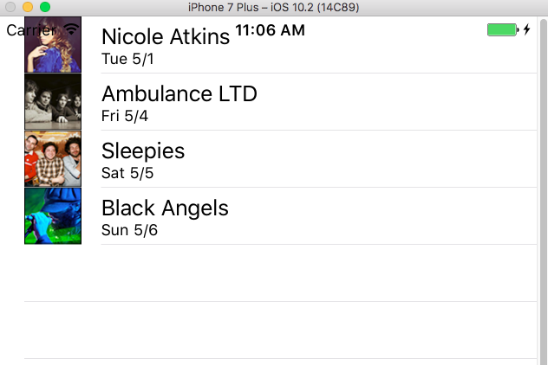
Notes:
As we mentioned earlier, the cells are now less tall than what we had in the previous exercise. The custom height of 88 that we used in our static example also needs to come from the code.

Slide 23
override func tableView(_ tableView: UITableView, heightForRowAt indexPath: IndexPath) -> CGFloat {
return 88
}
Notes:
The code we need can be found in the tableView class. Around line 44, find the word UITableView. Hold Ctrl and click on it. From the menu, choose Jump to Definition. This will take you to the actual UITableView Class file.
Around line 97, select the line of code shown below:
optional public func tableView(tableView: UITableView, heightForRowAtIndexPath indexPath: NSIndexPath) -> CGFloat
Then replace optional public with override. It should look like this:
RUN THE CODE

Slide 24
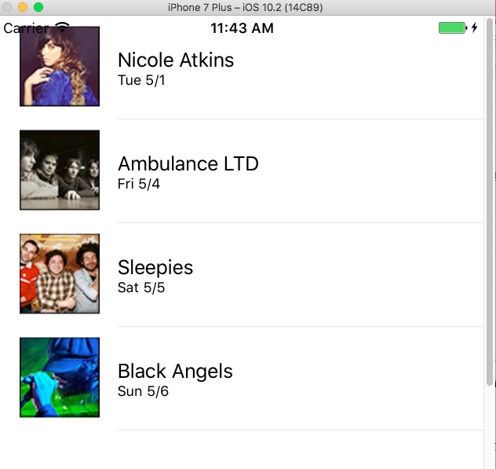
Notes:
YAY!
Next we’re going to create a detail view for the band

Slide 25
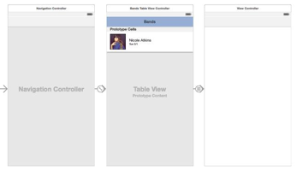
Navigation Controller
Notes:
In this exercise, we’re going to start to create a detailed view for the band information. When a user clicks one of the band cells in the table view controller, they will be taken to a view that lists detailed information about the band. To add this functionality to our app, we will use a Navigation Controller, a common element in most iPhone apps.
The Navigation Controller provides easy navigation between hierarchical content.
SAVE YOUR CODE – git add –A, git commit –m “pre nav”

Slide 26
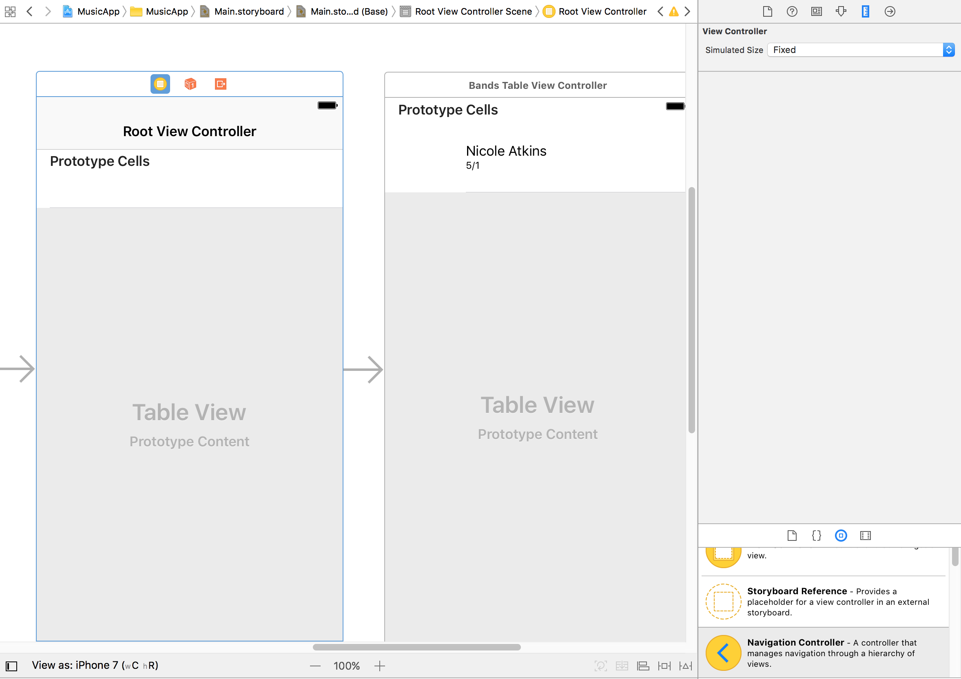
Notes:
Adding the Navigation Controller
In the Project Navigator click on Main.storyboard.
We need more room in the Editor area. If you see the Document Outline, click the Hide Document Outline button at the bottom left of the Editor area.
Go to the Object library in the Utilities area on the bottom right.
Find the Navigation Controller.
Drag it anywhere into the storyboard except over the existing Bands Table View Controller. It’s OK if it overlaps some, but try to minimize it as much as possible. We’ll perfect the position shortly.
If the Document Outline popped open again, click the Hide Document Outline button again.

Slide 27
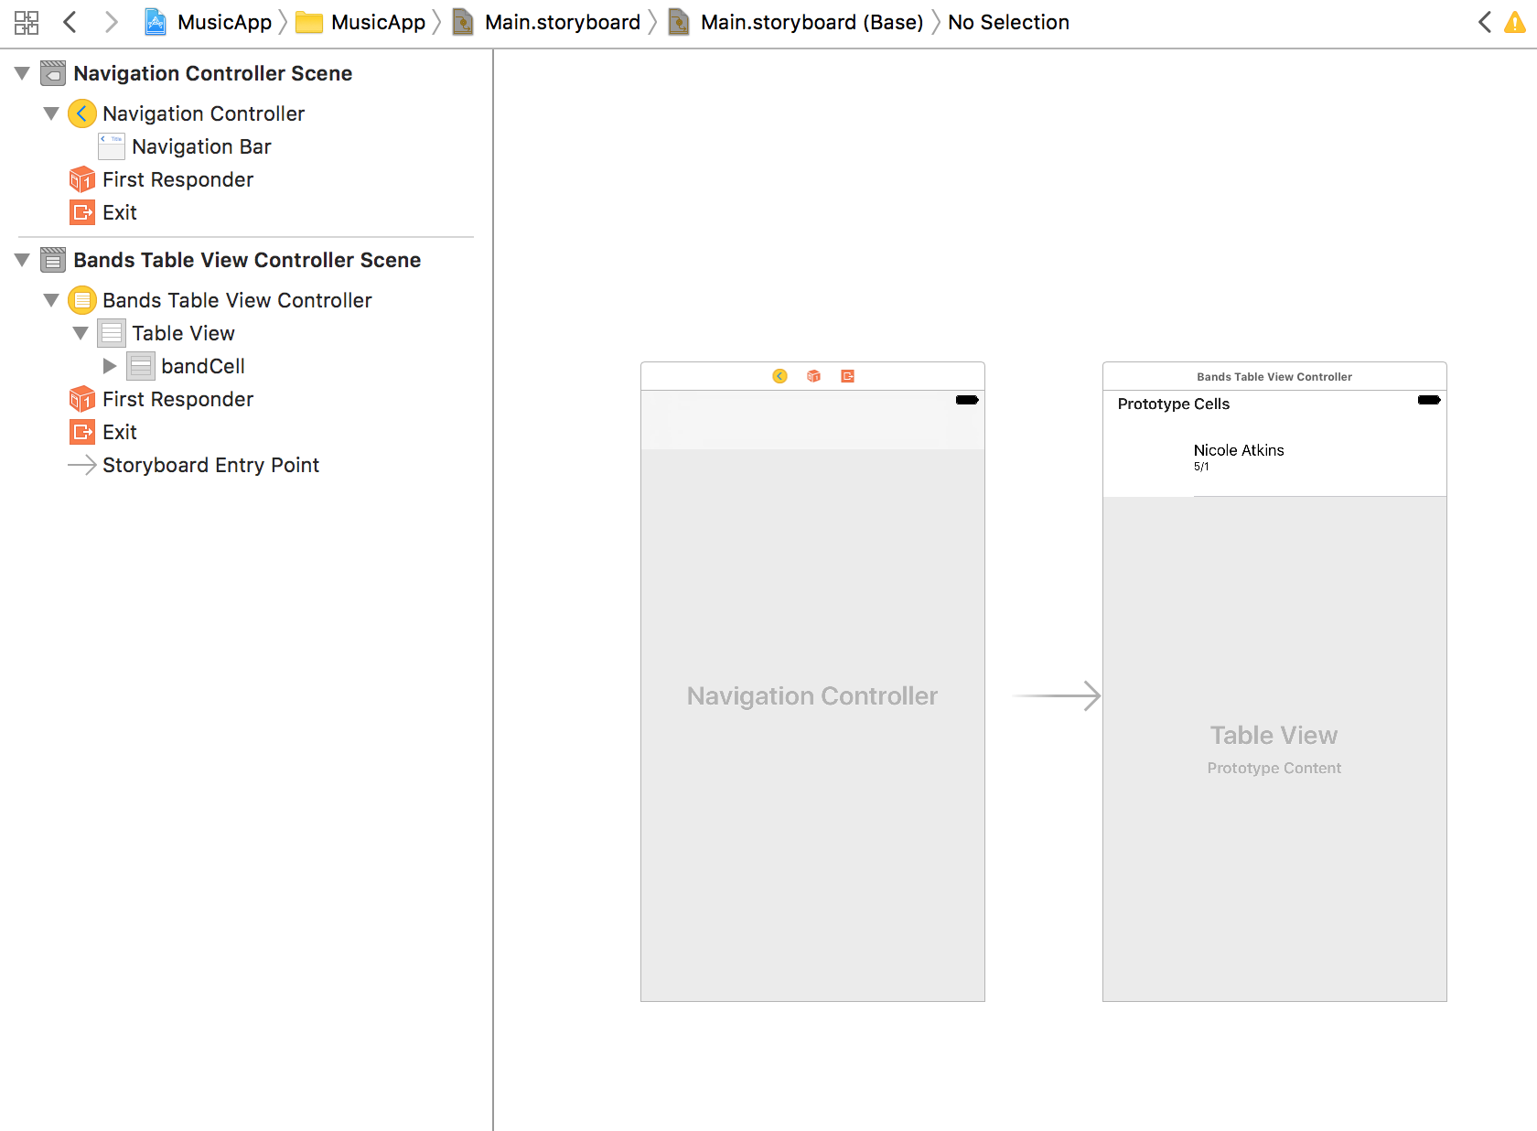
Notes:
Notice the Navigation Controller comes with two scenes:
Navigation Controller: manages the relationships and transitions between our views
Root View Controller: the first controller that is instantiated by the Navigation Controller
We actually want our existing Bands Table View Controller to be the first controller, so let’s delete the provided Root View Controller.
Click on any blank area of the storyboard so that nothing is selected.
Click onto the top bar of the Root View Controller so that it is outlined in blue.
Hit Delete.

Slide 28
Notes:
As we did with the Bands Table View Controller, we want to change the default square view size to one that looks more iPhone-like. Select the new navigation controller by clicking on its top bar so it’s outlined in blue.
As shown below, rearrange the remaining two controllers so that the Navigation Controller is on the left and they are lined up next to each other.

Slide 29
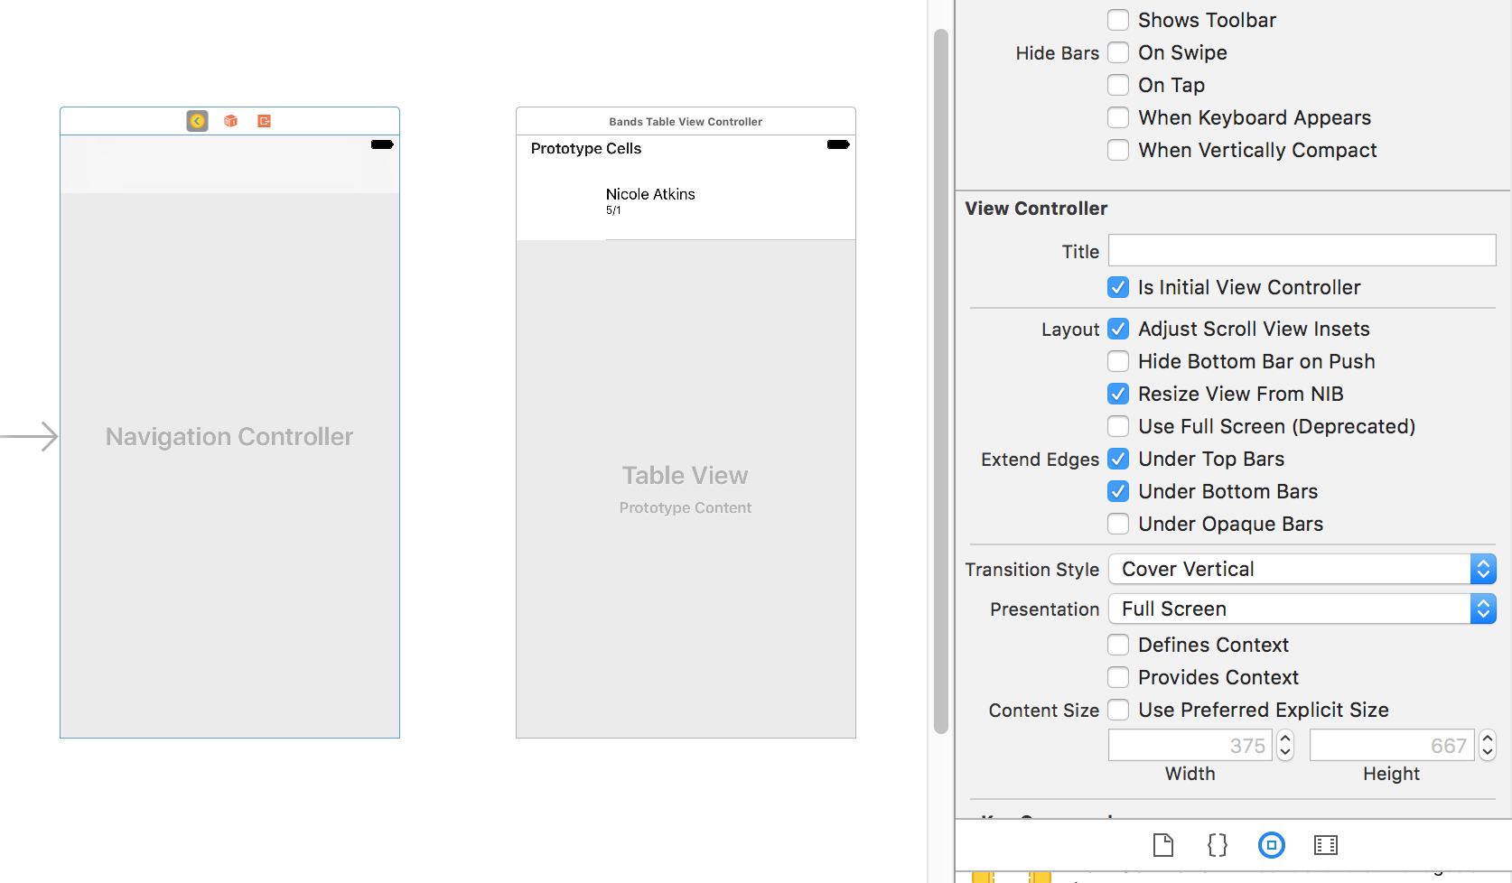
Notes:
Setting the Initial View Controller
We need to set the Navigation Controller as our Initial View Controller. Currently it’s set to our Bands Table View Controller. The gray arrow pointing to it signifies this. Let’s change it to the Navigation Controller.
Click on the top bar of the Navigation Controller to select it (it will become outlined in blue).
NOTE: If a controller is already selected and you click the top bar again, it will become deselected. Simply click it again to reselect it.
In the Utilities area on the right, click on the Attributes inspector tab .
In the View Controller section, check on Is Initial View Controller.
In the storyboard, notice that the gray arrow is now pointing to the Navigation Controller.

Slide 30
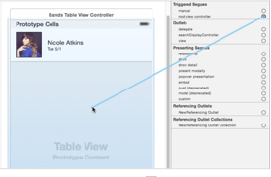
Notes:
Setting the Root View Controller
Now that we have the Navigation Controller as the initial view, we need to set the Bands Table View Controller as the root view controller so it is the first controller that users see. We can set this in the Connections inspector.
Make sure the Navigation Controller is still selected in the Editor (it should have a blue outline).
In the Utilities area on the right, click on the Connections inspector tab .
In the Triggered Segues section, find root view controller.
NOTE: If you don’t see anything under Triggered Segues, click on its name to expand it.
Mouse over the circle to the right of root view controller so it becomes a + sign.
Hold Ctrl and drag from the circle to the Bands Table View Controller then release, as shown below:

Slide 31
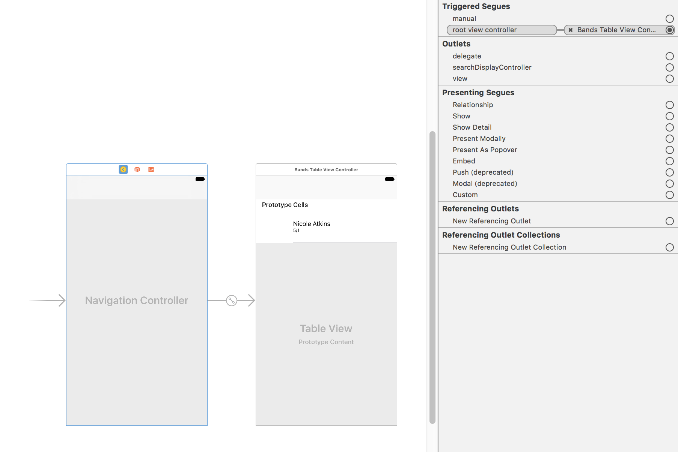
Notes:
Notice in the Connections inspector , root view controller is now connected to Bands Table View Controller.
This creates a connection between the two so that the Table View Controller is now the Root View Controller for the Navigation Controller.

Slide 32
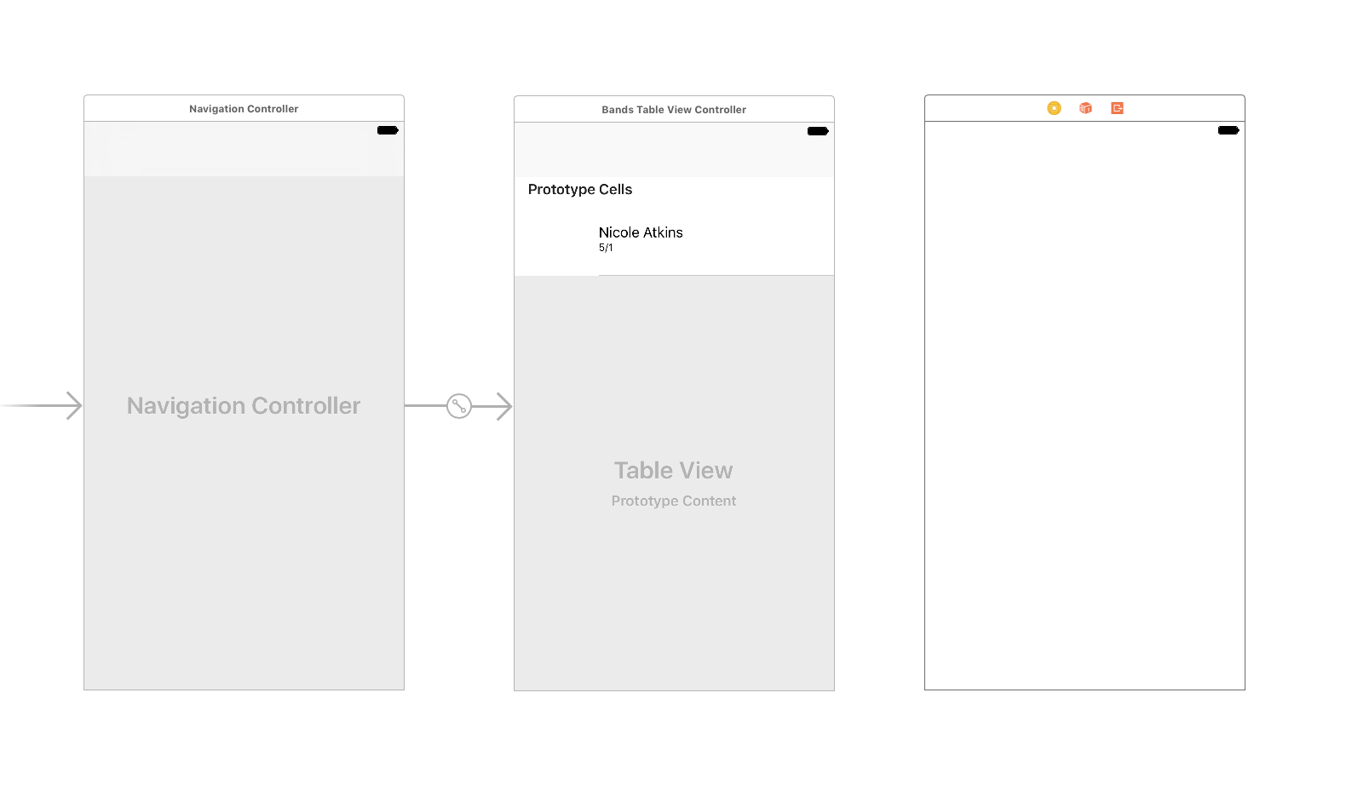
Notes:
Adding the Detail View Controller
We need to add a View Controller that will list the details about a band. In the
Object library , find the View Controller.
Drag the View Controller and drop it to the right of Bands Table View Controller in the Editor.

Slide 33
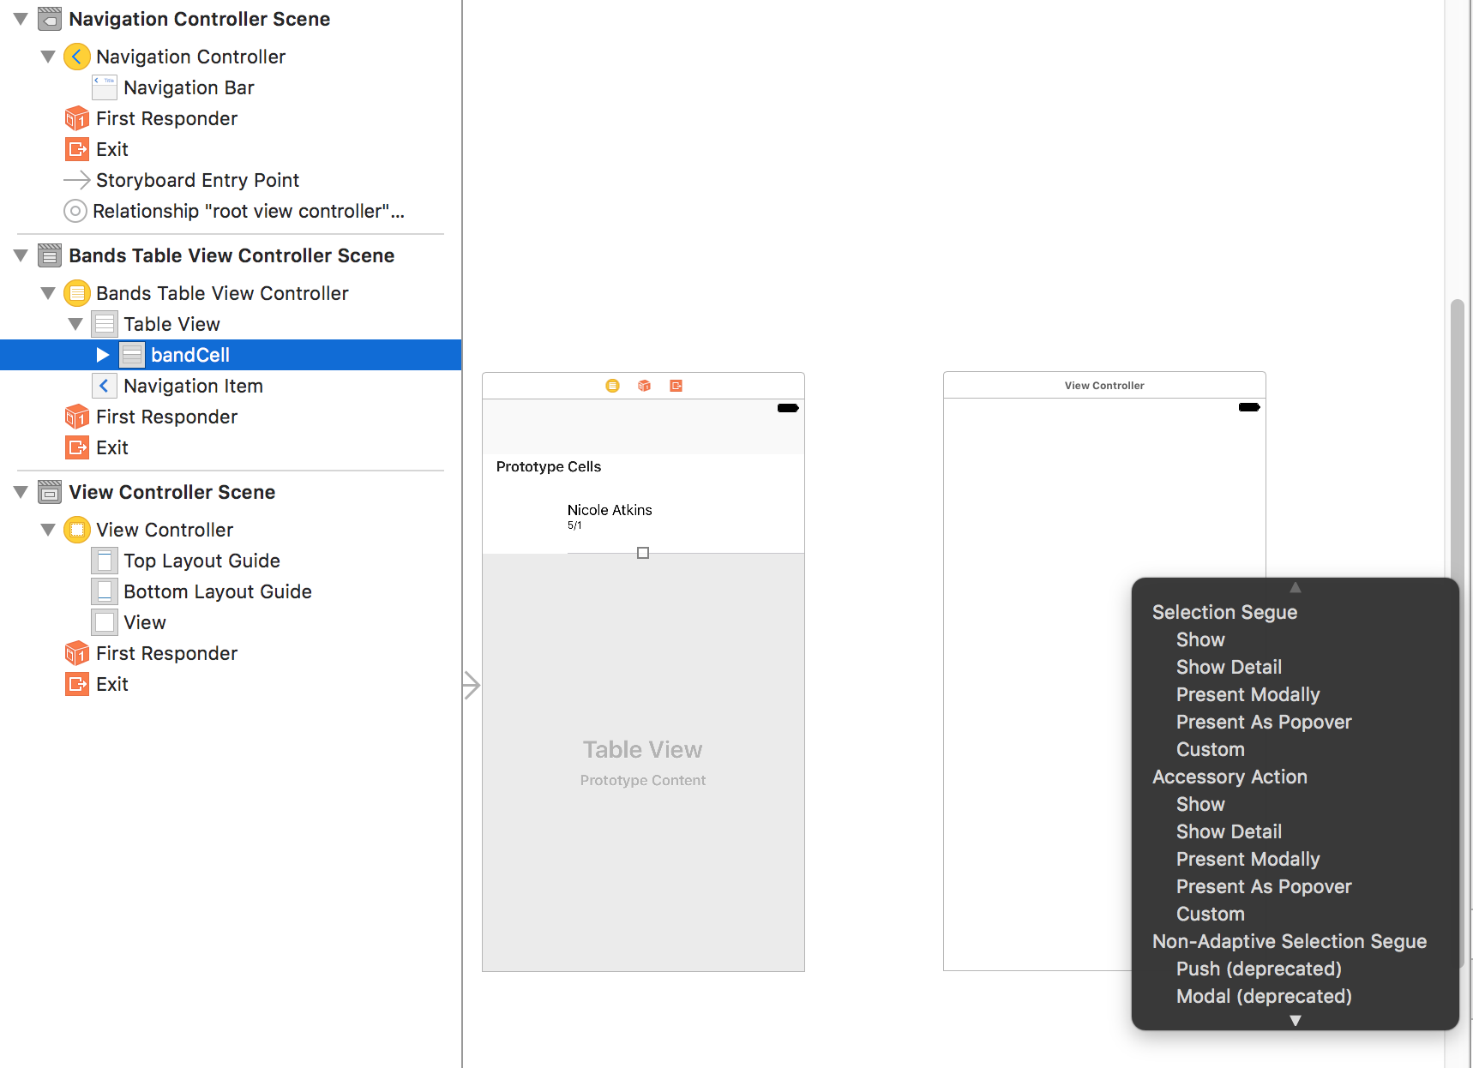
Notes:
Now that we have this new View Controller, we need to create a connection between it and the cell in our Bands Table View Controller, so that when a user taps on the cell they are taken to the new View Controller.
Hold Ctrl and drag from the Nicole Atkins cell to the View Controller on the right.
As shown below, a Segue menu will open. Under Selection Segue, click Show.

Slide 34
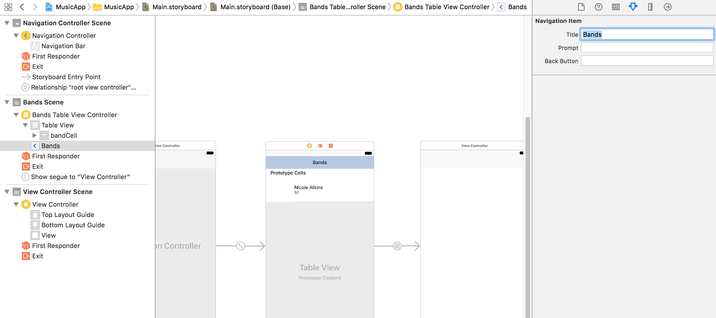
Notes:
In the Document Outline, expand Bands Table View Controller if it isn’t already.
Click on Navigation Item to select it.
In the Utilities area on the right, click the Attributes inspector tab .
Next to Title, type Bands and hit Return.
Notice the title bar at the top of the Bands Table View Controller has been updated.
Click the Run button.

Slide 35
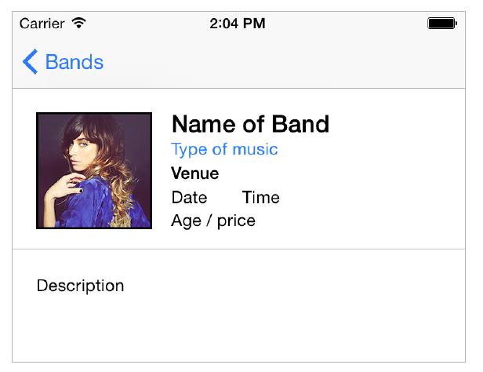
Notes:
Adding an Image Placeholder, Title, & Subtitle
Let’s start by adding placeholders for some detailed info. We’ll add a placeholder for an image of the band along with the band name and type of music.
In the Document Outline, under View Controller Scene, click View Controller to select it.
In the Utilities area on the right, click the File inspector tab .
To give you a better idea of the layout we want to create in this exercise, below is the final goal:

Slide 36
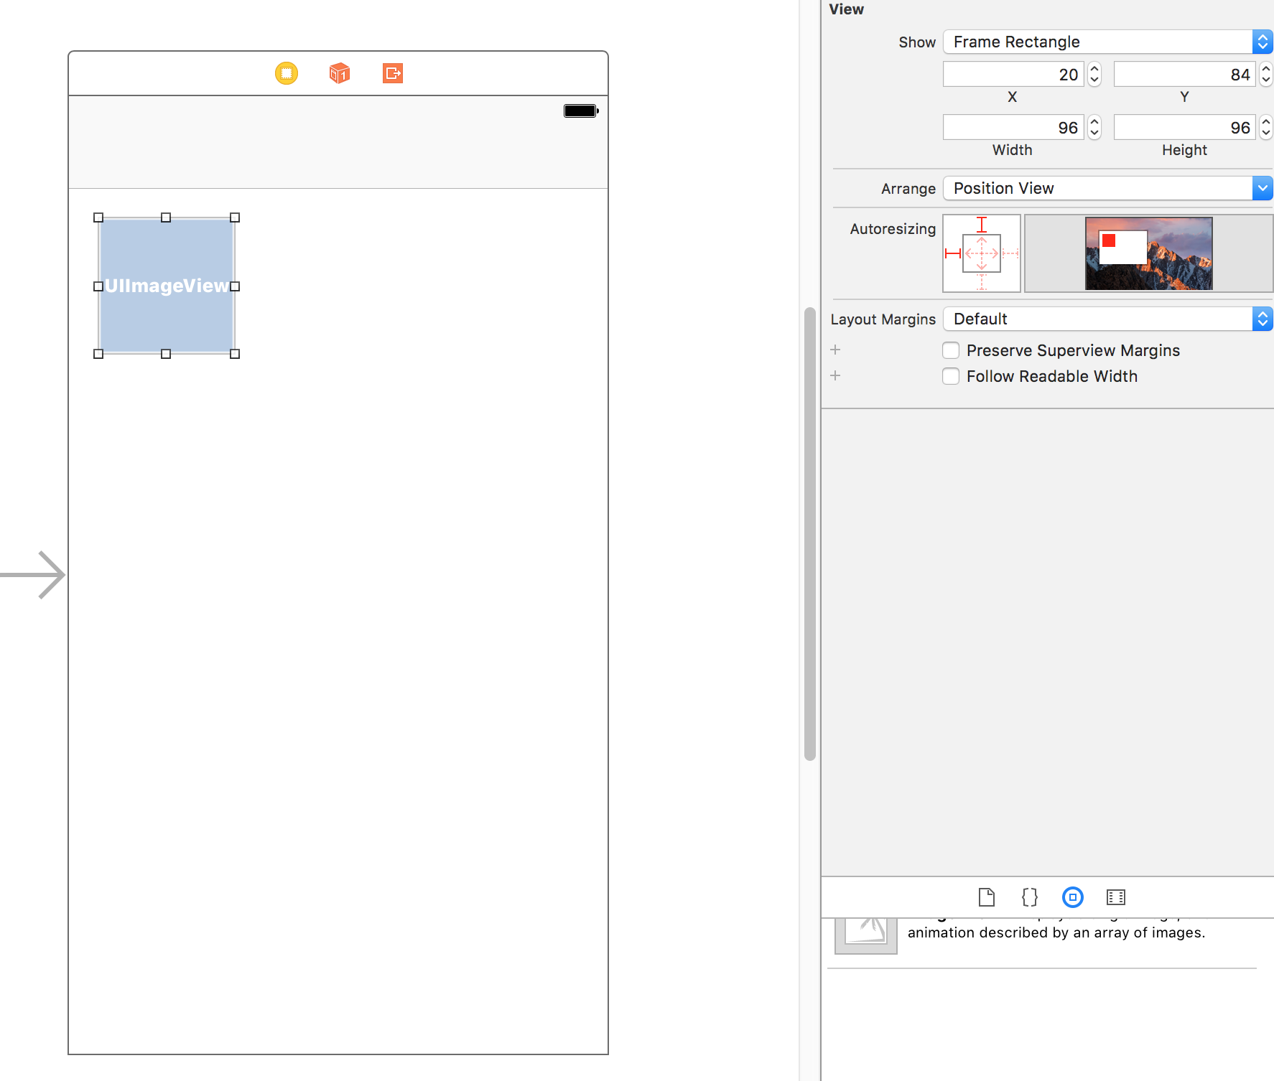
Notes:
Let’s start by adding the image placeholder. We can use the Image View object to display a single image. In the search bar at the bottom of the Object library , type: image
Image View will be the only object showing in the Object library.
Drag Image View onto the empty view controller in the storyboard. (Don’t worry about placement. We’ll fix that next.)
It’s too big, so let’s resize it. In the Utilities area on the right, click on the Size inspector tab .
Set the following (make sure you hit Return when you enter the final value):
X: 20
Y: 84
Width: 96
Height: 96

Slide 37
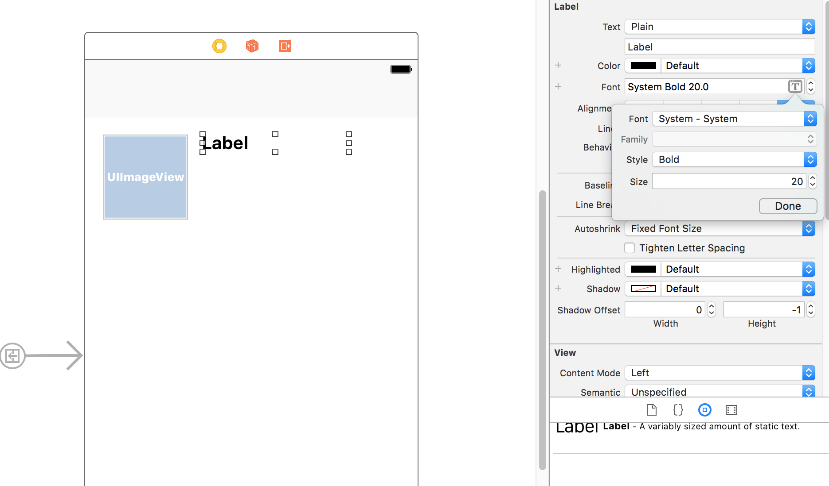
Notes:
Let’s add a label object for the band name. In the search bar at the bottom of the Object library , delete the text and type: label
Drag the Label to the right of the Image View object. Don’t worry about a specific position yet
Double–click on the Label in the Editor, change the name to Name of Band and hit Return.
In the Size inspector set the following:
X: 132
Y: 83
Width: 166
Height: 21
Click on the Attributes inspector tab .
To the far right of Font, click on the Text Menu icon and set:
Style: Bold
Size: 20

Slide 38
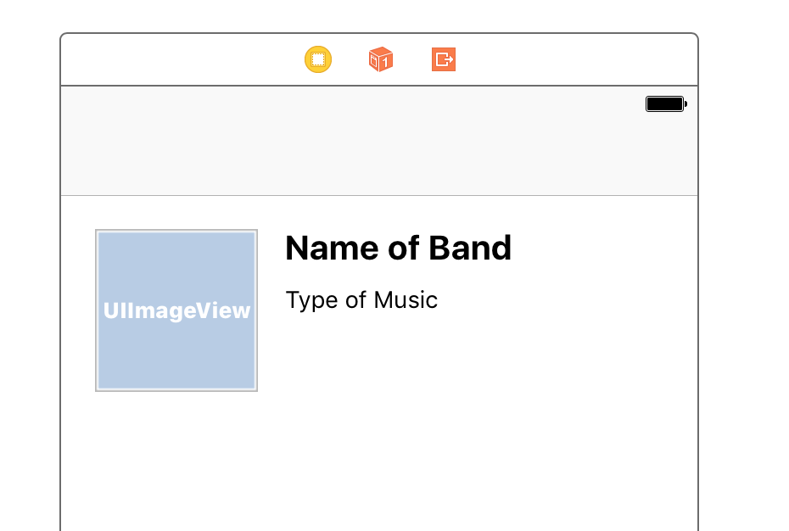
Notes:
Let’s add a label for the type of music. Drag out another Label from the Object library , and drop it below the Name of Band label. Don’t worry about its specific position yet.
Double–click the new Label you just added.
Rename it Type of music and hit Return.
With the Type of music label still selected, in the Attributes inspector , click on the Text Menu icon to the right of Font.
Change the Size to 14.

Slide 39
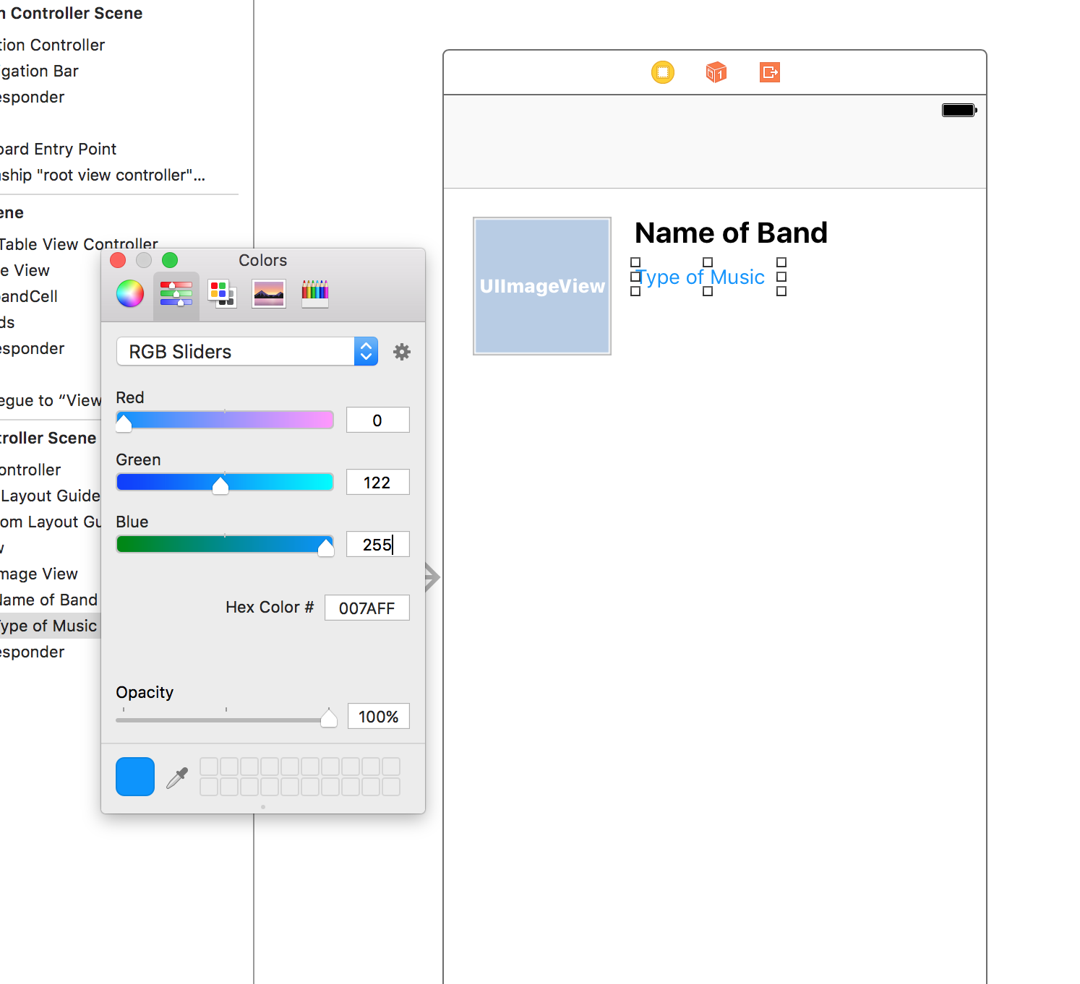
Notes:
Let’s change the Type of music label’s text color. In the Attributes inspector to the right of Color, click the menu that says Default.
If you see a blue color in the Recently Used Colors, select it and skip the next step.
To select a blue that matches Apple’s blue, do the following:
Choose Other to pull up the Colors window.
At the top of the Colors window, click the second tab .
In the Slider menu, select RGB Sliders if you don’t already see them.
Select a color with R:0, G:122 and B:255.
Close the Colors window.

Slide 40
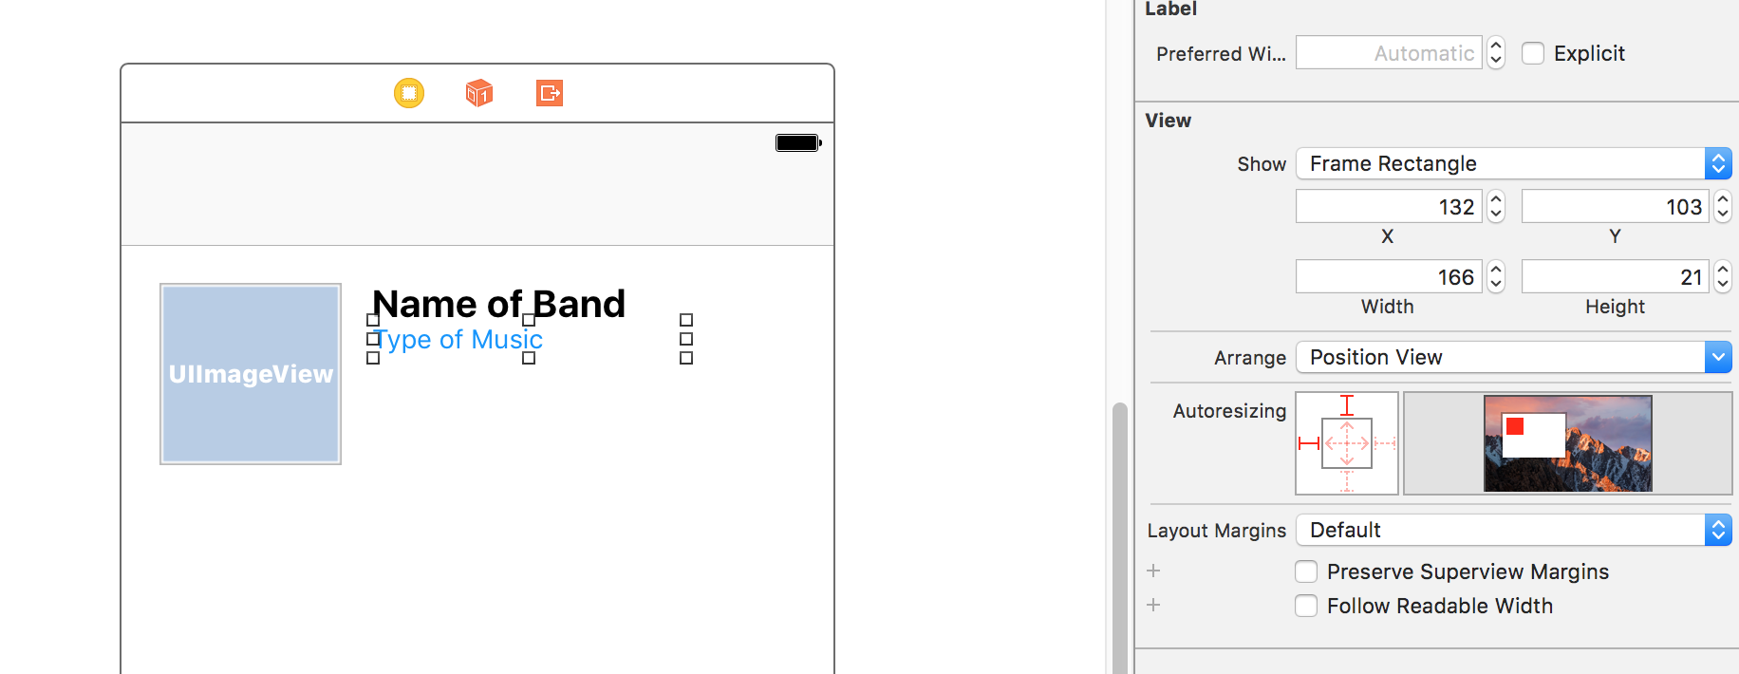
Notes:
With the Type of music label still selected, in the Size inspector set:
X: 132
Y: 103
Width: 166
Height: 21

Slide 41
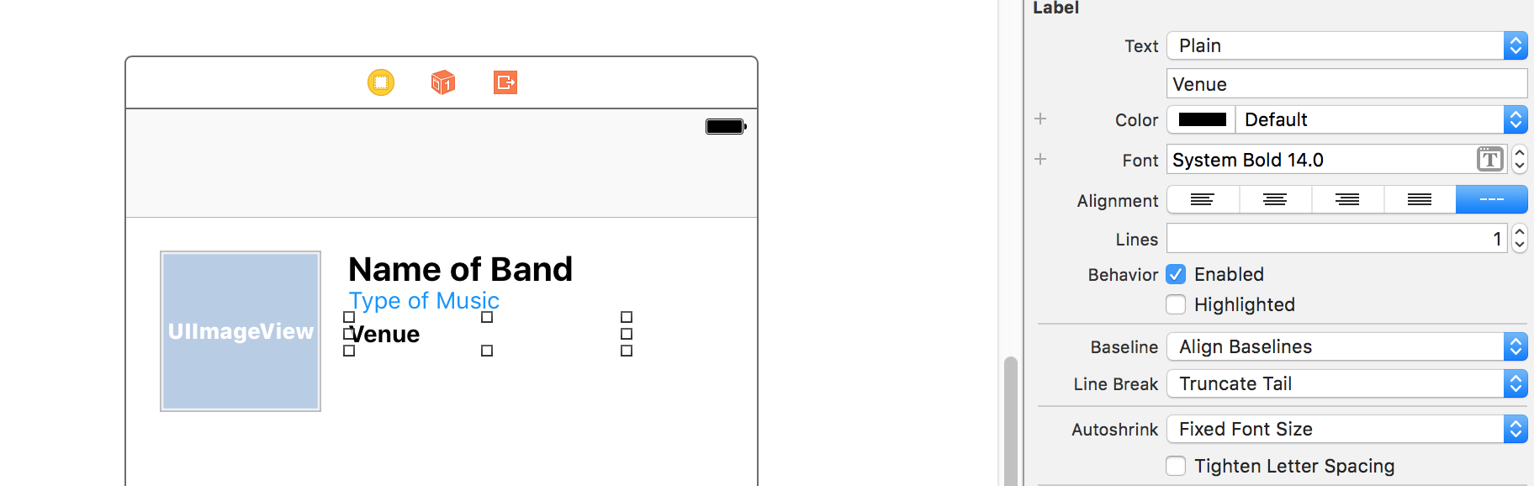
Notes:
Adding Show Info Labels
Next we will create labels for the date, time, and venue of the show.
From the Object library , drag out a Label and place it below the Type of music.
Double–click on the new Label, rename it Venue and hit Return.
With the Venue label still selected, in the Size inspector set:
X: 132
Y: 123
Width: 166
Height: 21
With the Venue label still selected, in the Attributes inspector , click on the Text Menu icon to the right of Font and set the following:
Style: Bold
Size: 14
Click Done.

Slide 42
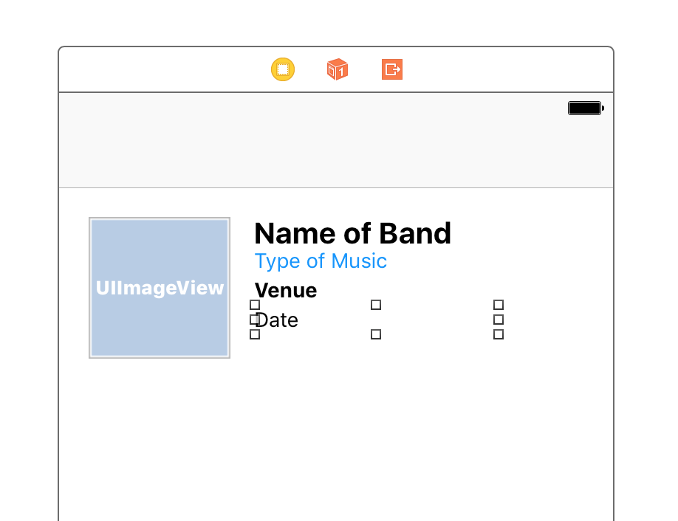
Notes:
We want to add a label for the date, and it should look similar to the venue label, so let’s duplicate it by dragging out a copy of it. Hold Option and drag the Venue label down to create a copy.
Double–click the second instance of Venue, rename it Date and hit Return.
With the Date label still selected, in the Attributes inspector , click on the Text Menu icon .
Change the Style to Regular.
With the Date label still selected, in the Size inspector set:
X: 132
Y: 143
Width: 55
Height: 21
We need another label for the time. The time will go to the right of the date, so hold Option and drag the Date label to the right to create a copy.

Slide 43
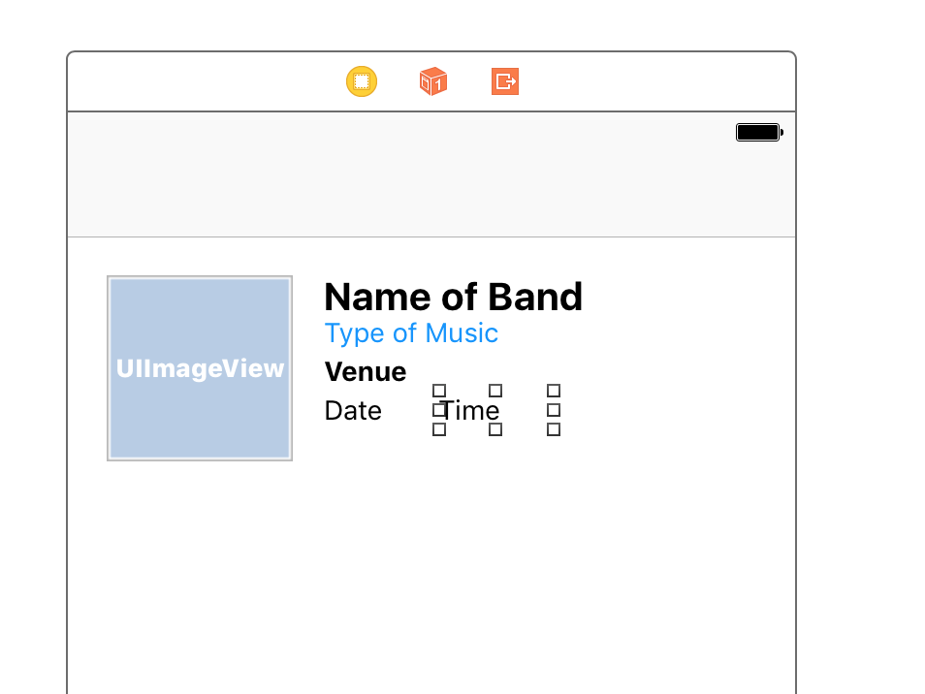
Notes:
Double–click on the copy you just created and rename it Time.
With the Time label still selected, in the Size inspector set:
X: 191
Y: 143
Width: 60
Height: 21

Slide 44
Notes:
Double–click the second (bottom) Date label and rename it Age / price.
With the Age / price label still selected, in the Size inspector set:
X: 132
Y: 162
Width: 166
Height: 21

Slide 45
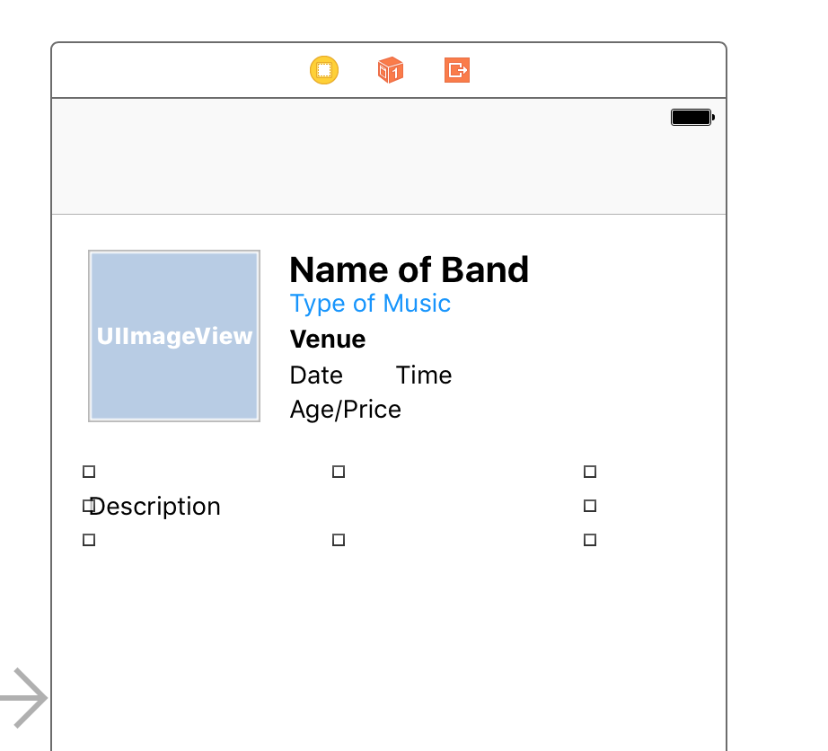
Notes:
Just one more label to go! Drag out a Label from the Object library , and drop it below the Image View.
Double–click the label, rename it Description and hit Return.
With the Description label still selected, in the Size inspector set:
X: 20
Y: 207
Width: 280
Height: 39
NOTE: The description could end up being one or two lines of text. Currently the text is vertically centered within the label area. The alignment would look odd if we sometimes have one line of text, and other times have two lines. In a later exercise we’ll programmatically set it to vertically align to the top.
As shown below, in the Attributes inspector to the far right of Font, click the down arrow until the font size ends up at 14.

Slide 46
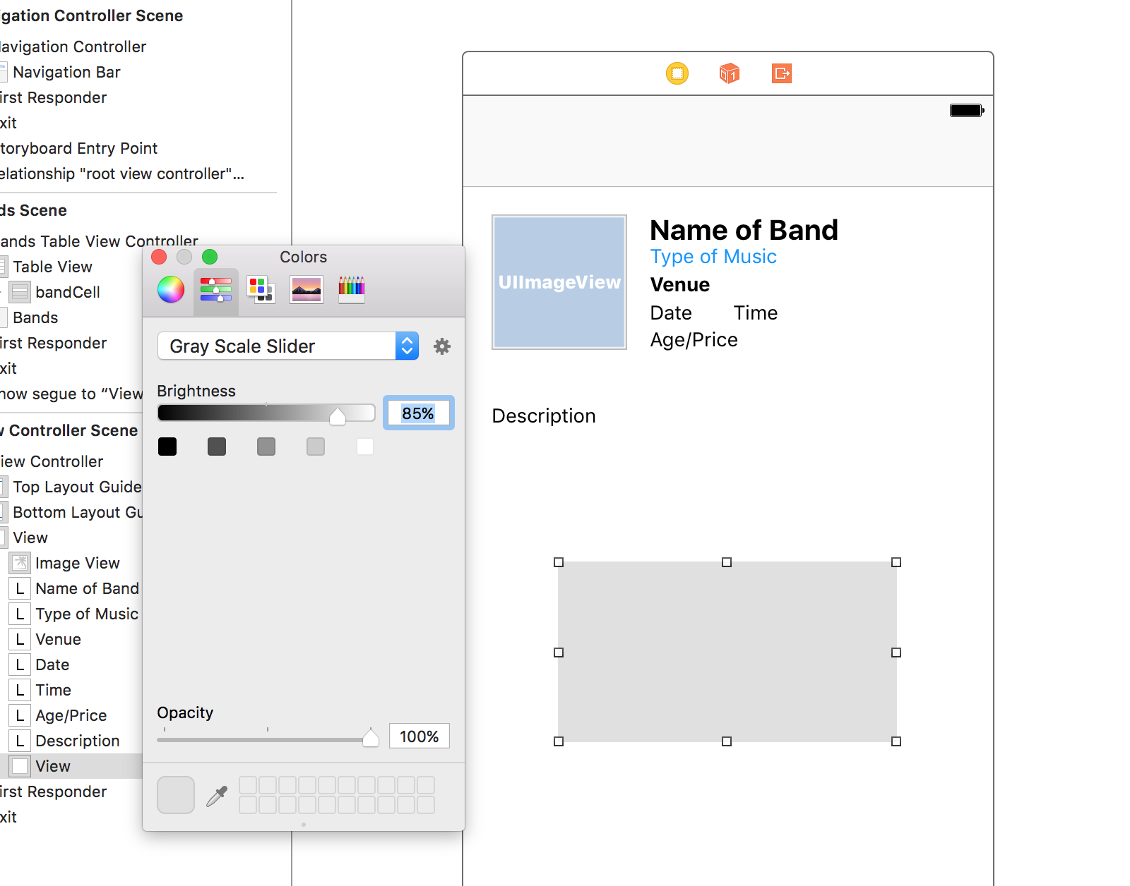
Notes:
Adding a Divider
Let’s add a horizontal line to visually separate the top info from the description. There’s no specific object to create a line, but we can use a short view as a line.
In the search bar at the bottom of the Object library , delete the text and type view.
NOTE: View will be one of the last objects listed in the Object library.
Drag the View object below the description. Don’t worry about the size and positioning, we’ll adjust that shortly.
In the Attributes inspector , next to Background click on the color bar to open the Colors window. (If a menu appears instead, choose Other and the Colors window will open.)
At the top of the Colors window, click the second tab to see the color sliders.
There will be a menu that says [Something] Sliders. From that menu choose
Gray Scale Slider.
To the right of the Brightness slider, type in 85 for the % and hit Return to apply it.
Close the Colors window.

Slide 47
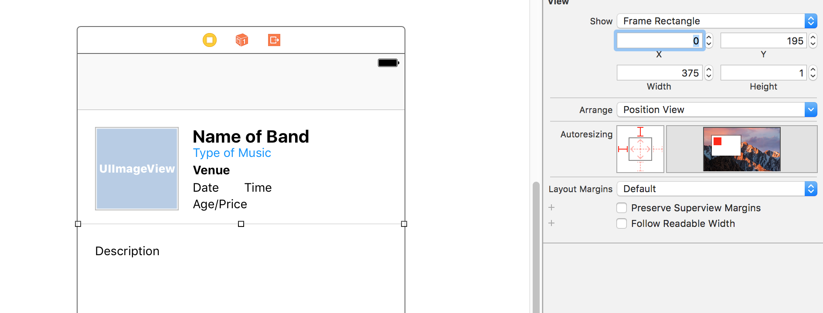
Notes:
In the Size inspector , set the following:
X: 0
Y: 195
Width: 375
Height: 1
Those settings should position the line between the description and the info above it. Please note that we’re leaving so much empty space below the description so we can add a video in a later exercise.

Slide 48
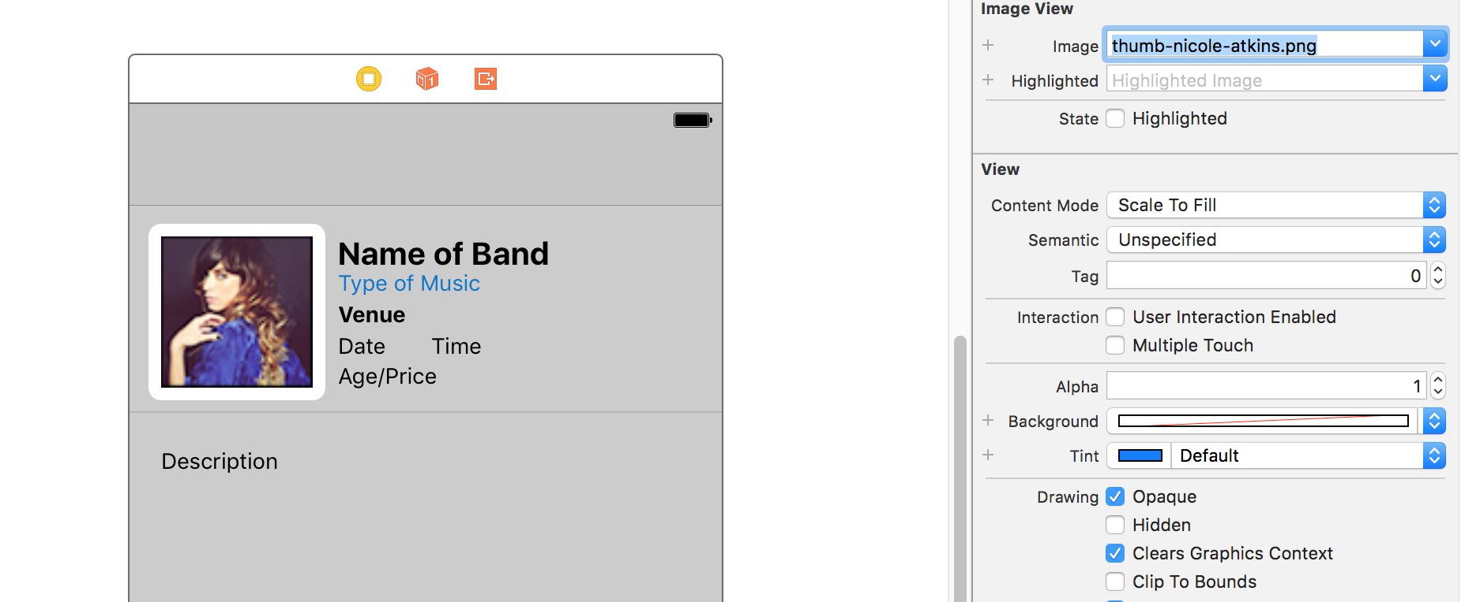
Notes:
In the Project Navigator, notice the files have been added at the bottom of the Images folder.
Click on Main.storyboard.
Click the Image View placeholder in the Editor
In the Attributes inspector , from the Image menu choose full-nicole-atkins.png.
Let’s see how this looks so far. Click the Run button.
When the app loads in the Simulator, click on any of the bands to view the detail view we just made. Awesome!
NOTE: Currently, clicking any cell will lead to the same detail view. In the next exercise, we’ll show you how to code the app so the details for each of the bands are shown.
RUN APP

Slide 49
Notes:
In this exercise, you’ll learn how to create a segue in order to pass information between views.

Slide 50
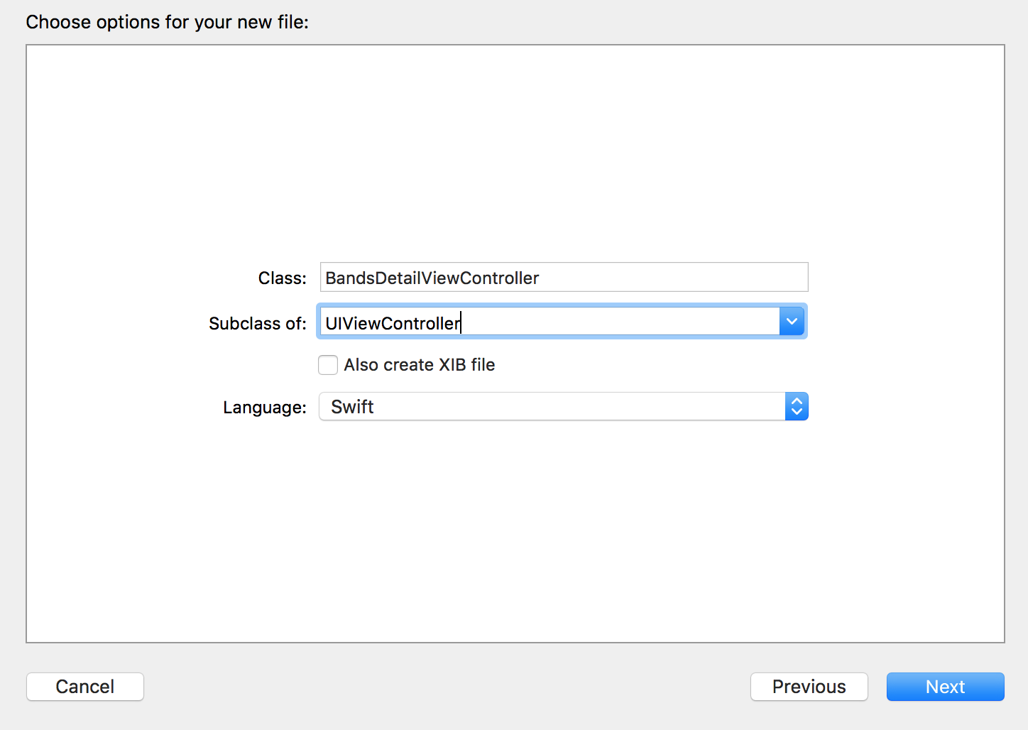
Notes:
In the Project Navigator, select BandsTableViewController.swift. (We want the file to be added after this file, that’s why we had you select it.)
Go to File > New > File (or hit Cmd–N).
Make sure on the left, under iOS, Source is selected.
Double–click Cocoa Touch Class to choose it.
From the Subclass of menu, choose UIViewController (or start typing it and let Xcode autocomplete it for you).
For the name of the Class, add BandsDetail at the start, so the Class ends up being
BandsDetailViewController. (Notice that is Bands plural, not Band!)
NOTE: UIViewController is the type of object we are currently using on the storyboard. By making our class a subclass of the UIViewController, it will have all the functionality it currently has, plus any additional functionality we add in the code to this new BandsDetailViewController class.
Click Next.
You should already be in the Jive Factory folder, so click Create.
Notice a BandsDetailViewController.swift file has been added in the Project Navigator. Now we need to link it to the view controller in the storyboard.

Slide 51
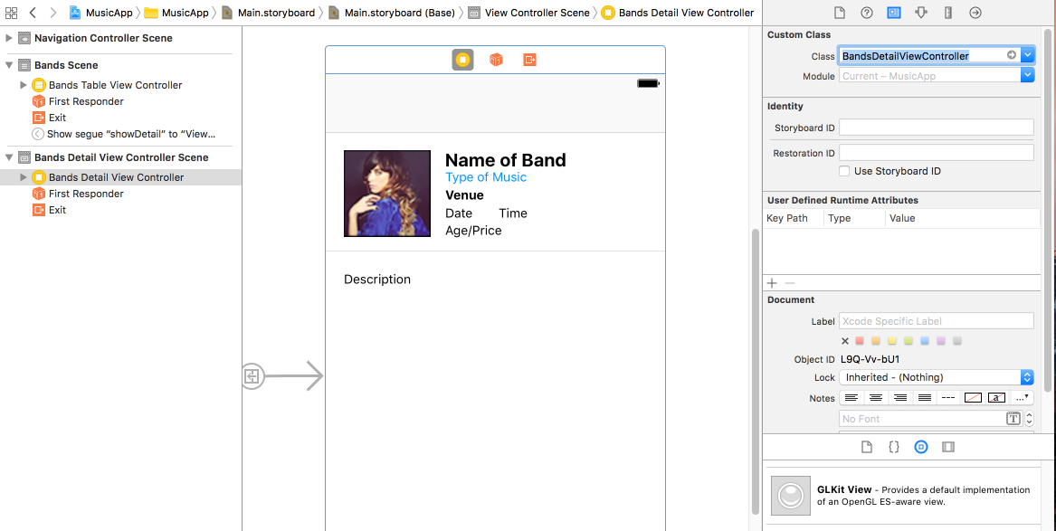
Notes:
In the Project Navigator click on Main.storyboard.
In the Document Outline, select View Controller (inside View Controller Scene). It will become outlined in blue to indicate it’s selected.
In the Utilities area on the right, click on the Identity inspector tab .
Next to Class, type B and it should autocomplete to BandsDetailViewController and then you hit Return to apply it. Now it’s connected to our new class.

Slide 52
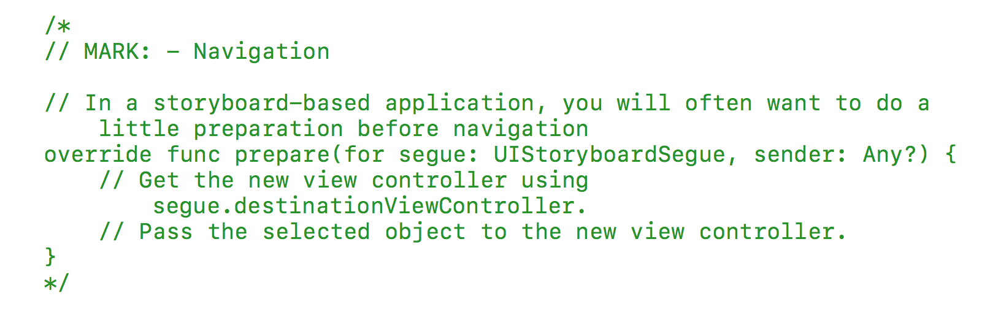
Notes:
segue (pronounced seg-way) objects perform the visual transition between view controllers. Before this transition occurs, a prepareForSegue(segue: UIStoryboardSegue, sender: AnyObject?) method is called in the source view controller. It is in this method that we may choose to pass some data to the destination view controller.

Slide 53
override func prepareForSegue(segue: UIStoryboardSegue, sender: AnyObject?) {
if (segue.identifier == "showDetail") {
If let indexPath = self.tableView.indexPathForSelectedRow { let bandsDetailViewController:BandsDetailViewController =
segue.destinationViewController as! BandsDetailViewController
}
}
}
Notes:
Let’s break this code down. The prepareForSegue method was conveniently written for us by Xcode. Inside this method we wrote an if statement that checks to see which segue was triggered. If that segue’s identifier is equal to showDetail then the code inside the if statement is executed. showDetail is the name we’ll assign to our segue (which we’ll do a bit later).
Inside the first if statement is another if statement which asks the current table view for the index path of the row that was selected. The index path is how we know which row was tapped. This will help us set the correct info for each band later.
The first line of code inside the second if statement sets the view controller we are transitioning to, which is BandsDetailViewController.

Slide 54
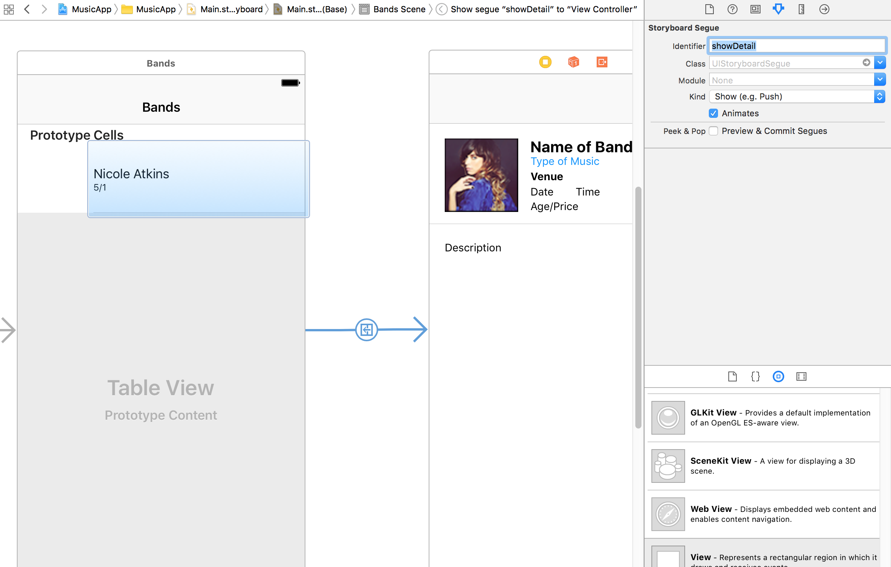
Notes:
In the Project Navigator, click Main.storyboard.
As shown below, in the Editor, click on the segue between the Table View and Detail View Controllers to select it.
In the Utilities area on the right, click the Attributes inspector tab .
Next to Identifier, type showDetail and hit Return.
The code inside the if statement in the prepareForSegue method will now execute when this segue happens. Next we can work on passing along the necessary information.

Slide 55
Agenda
Chapter 3 and 4 from Nobledesktop book
Assignments – Word Count, Features list

